Slide 1
Introduction to Computing for Data Analysis
Preprocessing unstructured text
Rachel Wiseley
Teaching Assistant
School of Computational Science and Engineering
Regular Expressions - Metacharacters
Notes:
As Vaishnavi mentioned, regular expressions are extremely useful when users want to search for a pattern.
Regular expressions is a special language for encoding these patterns.
Some useful times to use regular expressions includes:
Extracting URL results from Google
Matching a username or password
Now that we understand the usefulness of regular expressions, we need know how to formulate the expressions.
The first thing we need to talk through are metacharacters. These are special characters that don’t match themselves when used.

Slide 2
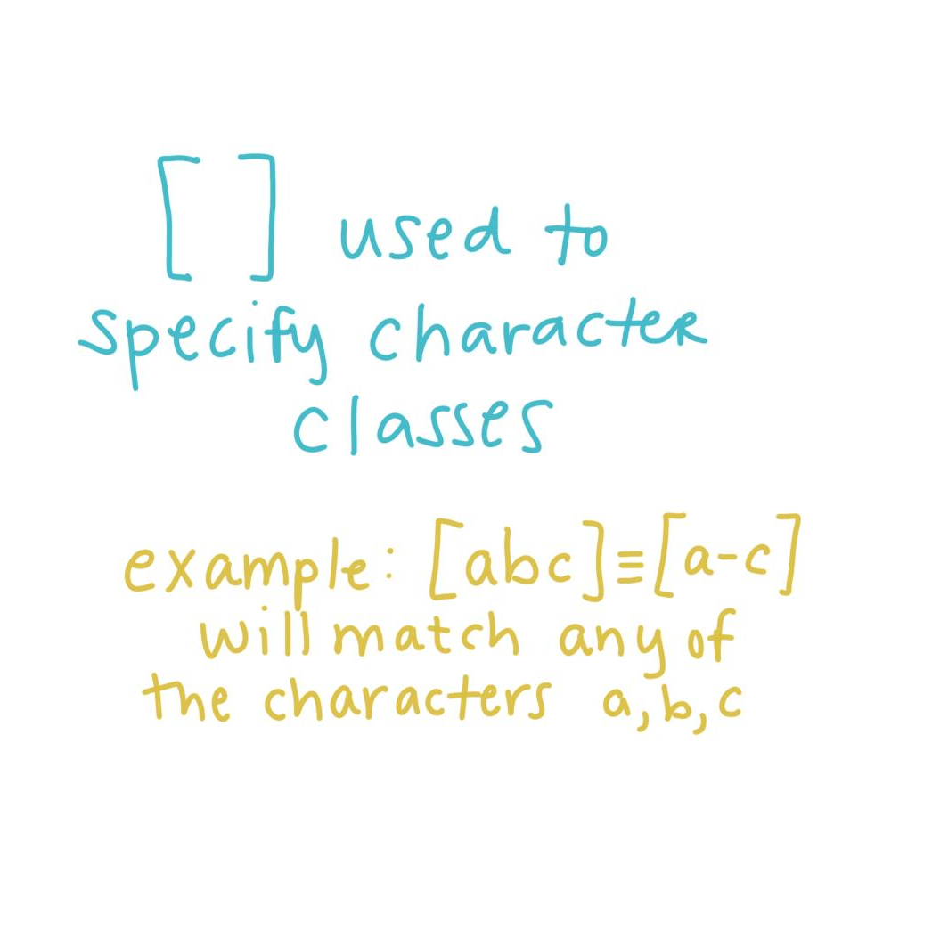
Notes:
The first metacharacter that we will discuss is the square bracket, [ ]. The square bracket is used to specify character classes. For example, [abc] is equivalent to [a-c] and will match any of the character a, b, or c in a string.

Slide 3
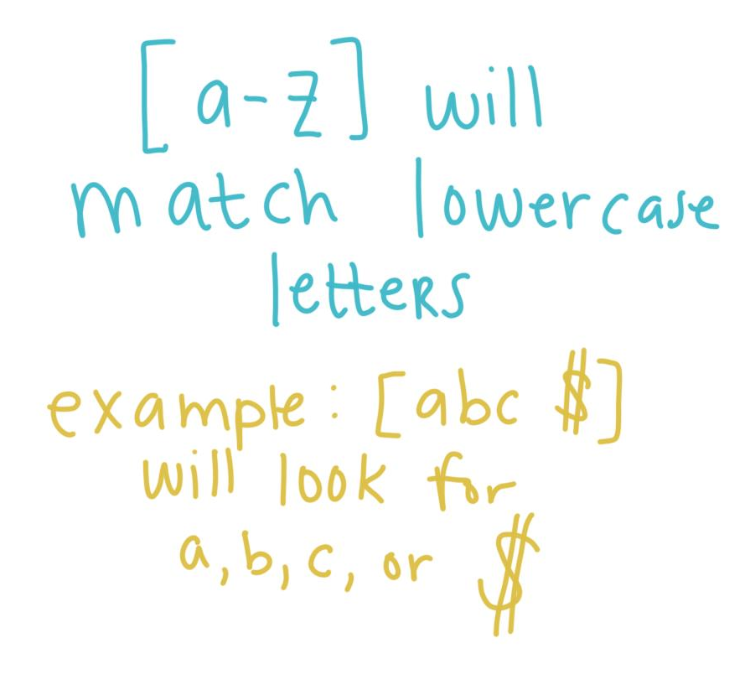
Notes:
Similarly, [a-z] will match lower case letters.
Another example, [abc$] will look for a,b,c, or $ (even though the $ sign is a metacharacter)

Slide 4
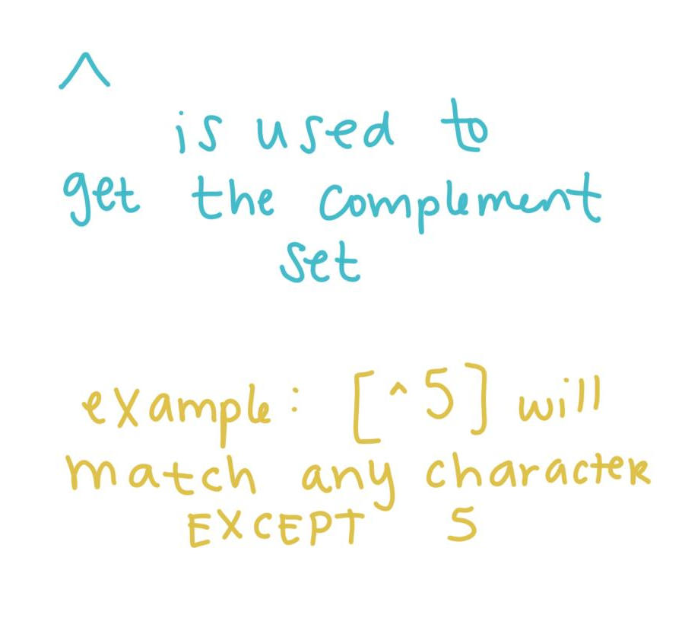
Notes:
The second metacharacter that is important to discuss is the carrot key, ^. This character (when used with square brackets) is used to get the complementing set. For example, [^5] will match any character except 5.

Slide 5
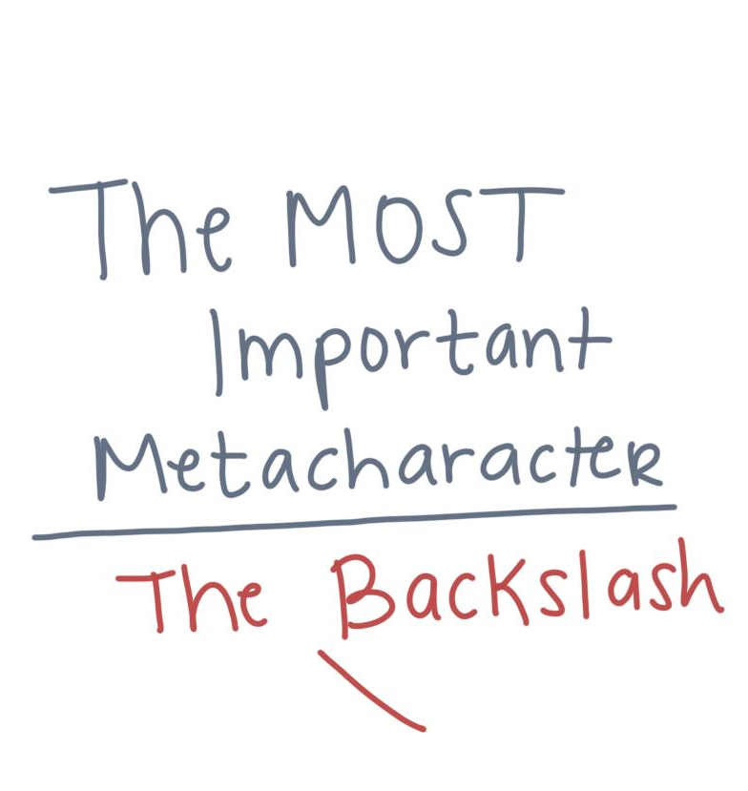
Notes:
The most important metacharacter is the backslash,\.

Slide 6
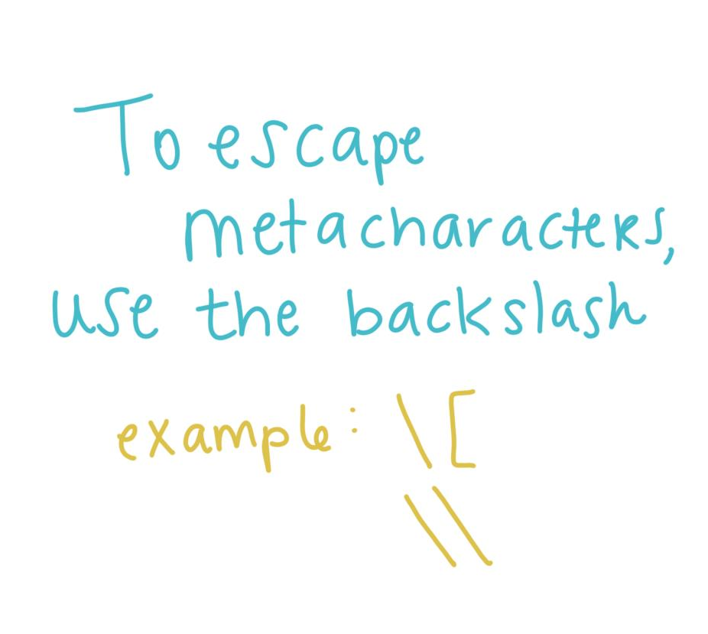
Notes:
In Python string literals, the backslash can be followed by various characters to signal various special sequences. It can also be used to escape other metacharacters.

Slide 7
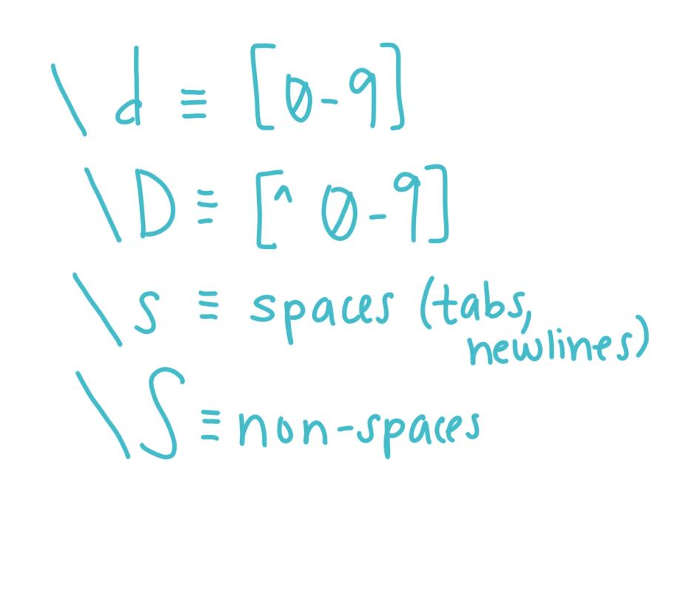
Notes:
Furthermore, there are special sequences which begin with a backslash that represent predefined sets of characters. There are special sequences for decimal digits and non-decimal digits.
Then there are some for matching any whitespace character.

Slide 8
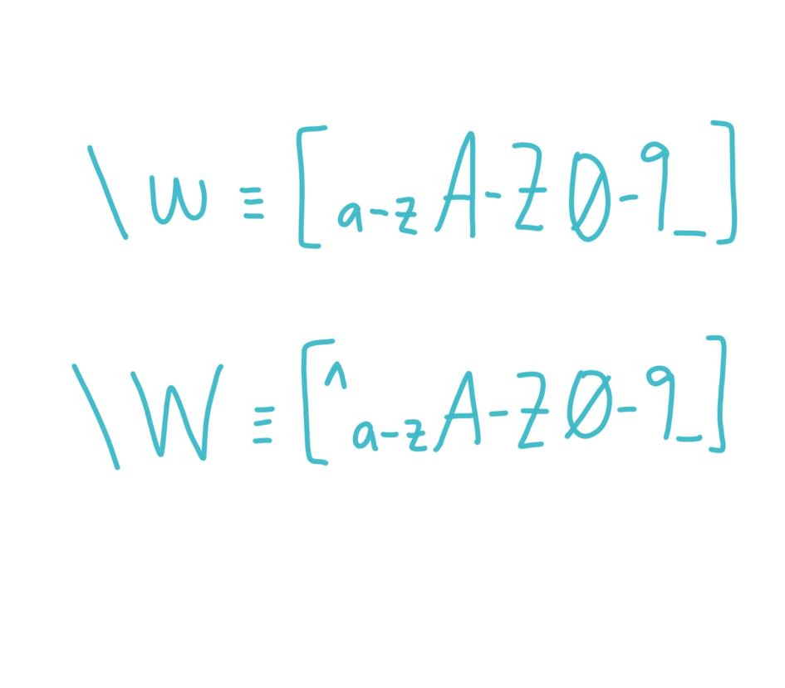
Notes:
There are some for matching any alphanumeric character.

Slide 9
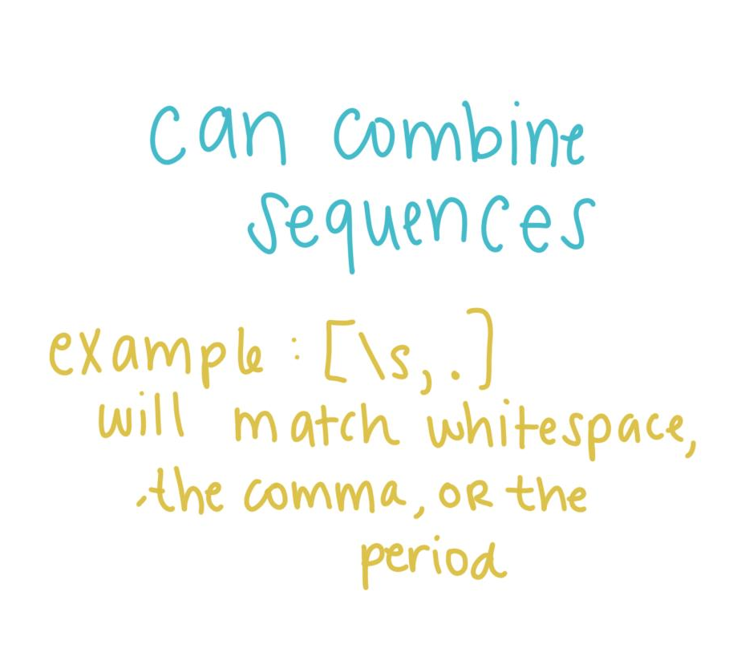
Notes:
Furthermore, we can combine these special sequences with a character class. For example, [\s,.] will match whitespace characters, commas or periods.

Slide 10
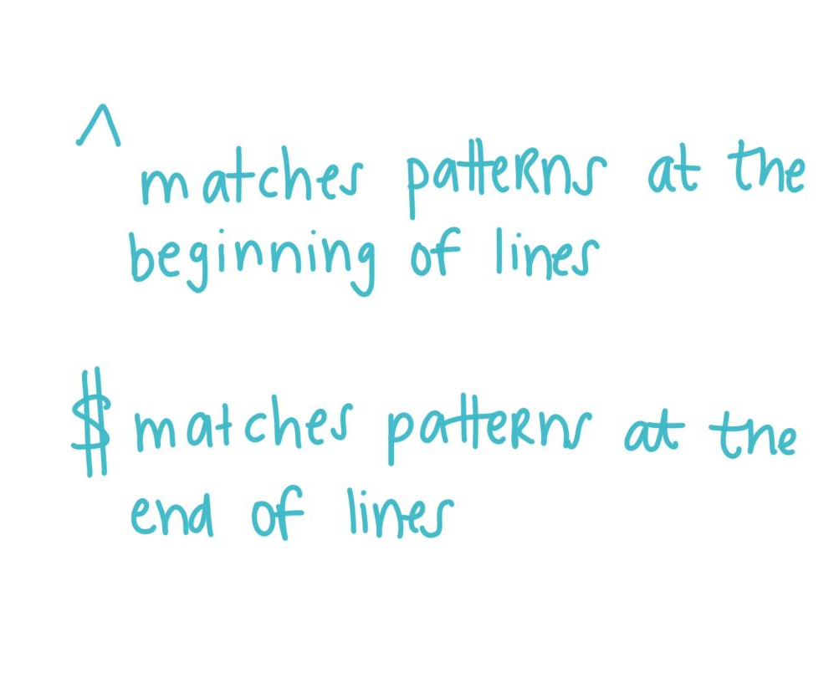
Notes:
There are a few other uses for metacharacters. The first involves alternative uses for the carrot key. When put at the beginning of a sequence, it denotes that the pattern should be matched at the beginning of the line. Similarly, the dollar symbol matches at the end of the line.

Slide 11
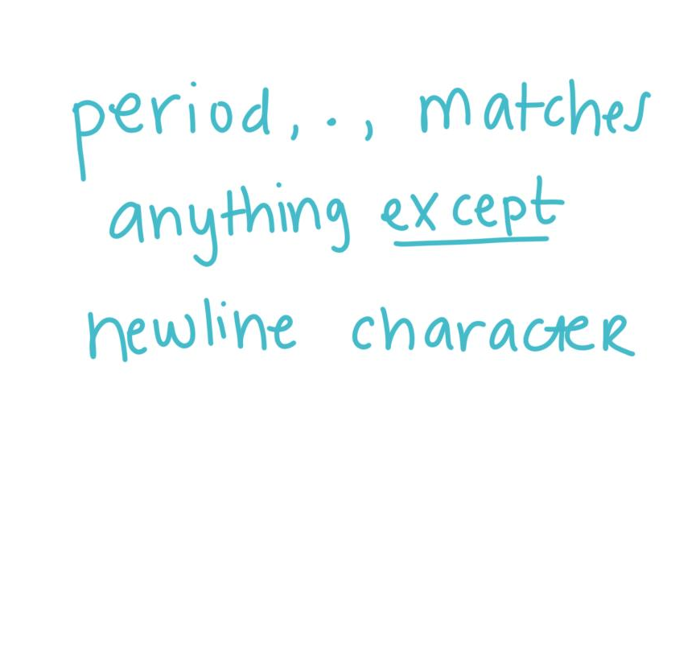
Notes:
The next special character is the period. It is used to match anything except a newline character.

Slide 12
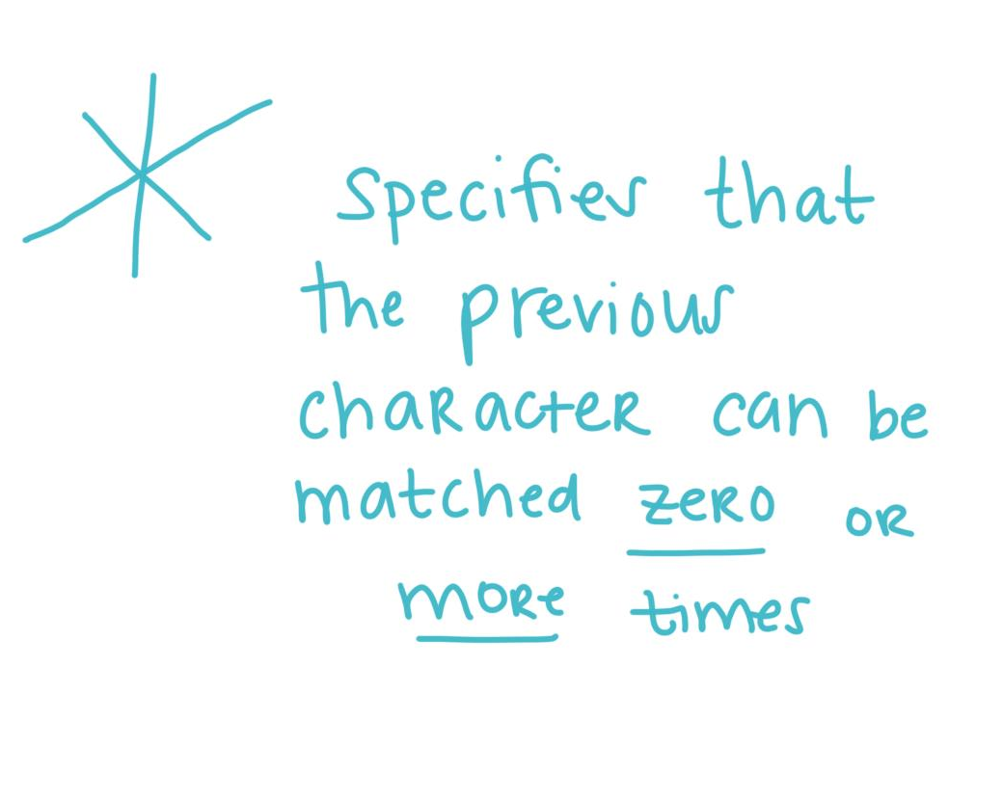
Notes:
Finally, the last metacharacter we will discuss is the asterisk,*. This character specifies that the previous character can be matched zero or more times.

Slide 13
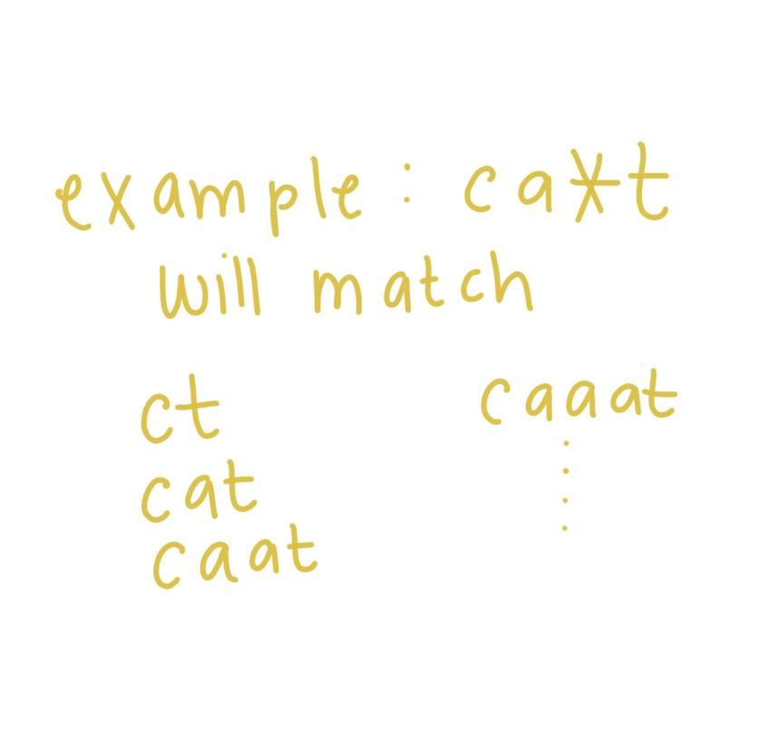
Notes:
An example using the asterisk is ca*t. This says that “a” can be matched zero or more times. Hence we will be able to match ct, cat, caat, caaat, etc.

Slide 14
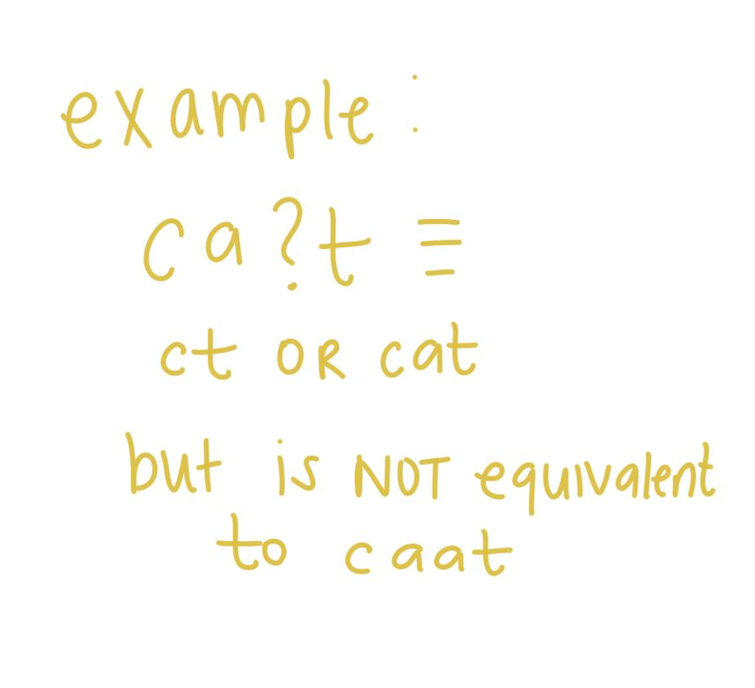
Notes:
There are other ways of repeating or counting with regular expressions. We can use the plus symbol, +, to look for one or more of a specific symbol. Additionally, the question mark, ?, can be used to look at zero or one of the previous character. Continuing our cat example from above, ca?t would match ct or cat but not caat.

Slide 15
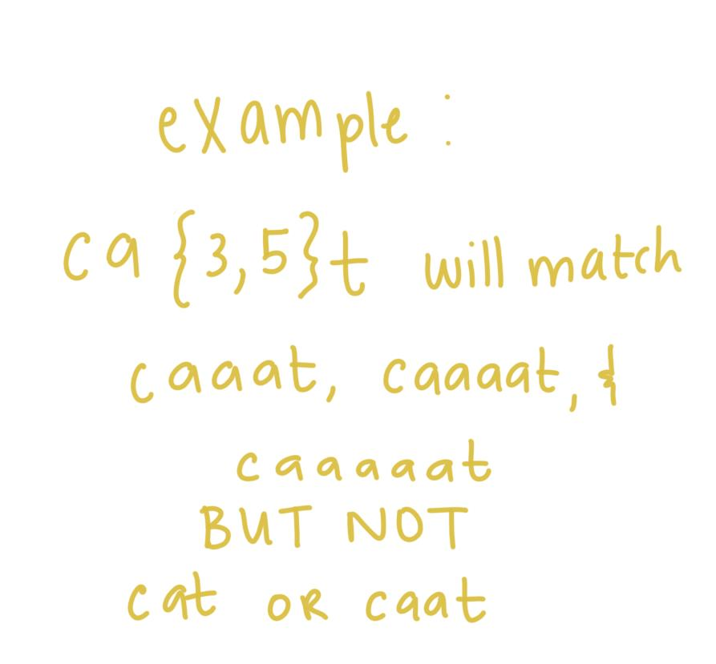
Notes:
We can also specify the count of the letter that we want. Using {m,n} in conjunction with our cat example, let m = 3 and n = 5. Then ca{3,5}t would match caaat , caaaat, and caaaaat but not cat or caat.
Now that we have learned the components of regular expressions, we need to discuss how we can group the components together.

Slide 16
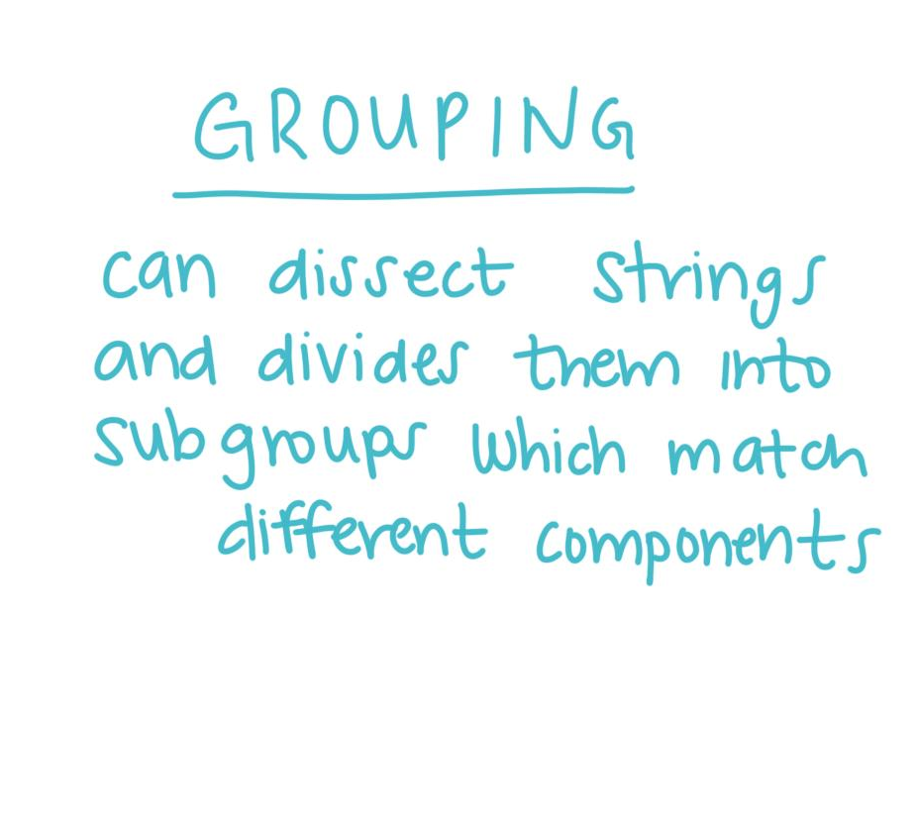
Notes:
Grouping allows us to dissect strings and divide them into different subgroups which will allow us to match different components.

Slide 17
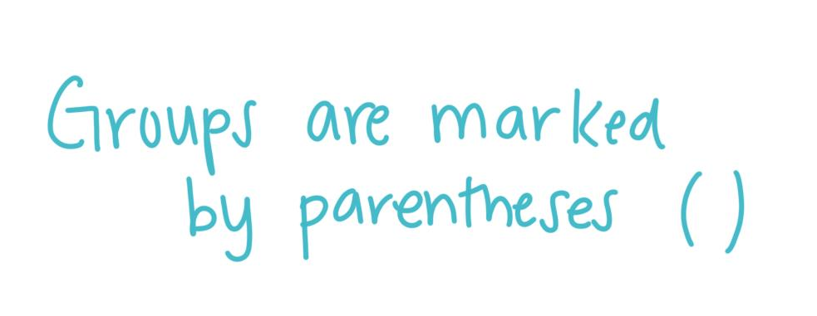
Notes:
We can denote groups using parentheses ().

Slide 18
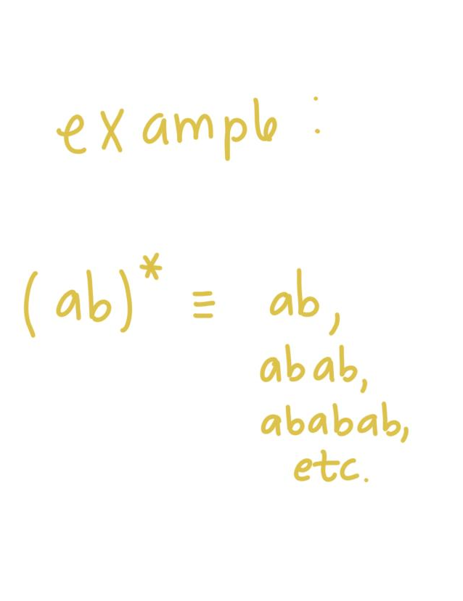
Notes:
So for example, by grouping ab inside the parentheses and then putting an asterisk behind it, we are saying we can match ab zero or multiple times.

Slide 19
Notes:
Let’s check our understanding of grouping and then we can walk through a real world example of using regular expressions.

